Slide 1
Special Topics
Lab Updates,
MPI & Dining Philosophers
NEU – 2016

Slide 2
Kernel Feedback
Q n A
NEU – 2016

Slide 3
NEU Kernel Questions
Why every hacker should know and use Linux
https://www.kali.org
Monolithic or micro kernel?
https://en.wikipedia.org/wiki/Linux_kernel#Tanenbaum.E2.80.93Torvalds_debate
How to write a kernel?
Multiple kernels
Deleting old ones?

Slide 4
How can we configure a reasonable kernel?
How does compiling a kernel run out of space?
We’re generating and saving numerous intermediate object files needed for the final executable
http://faculty.cs.niu.edu/~mcmahon/CS241/Notes/compile.html
Why does defconfig work and menuconfig fail
Why do I need ncurses library before menuconfig
Virtual Machine Limitations
Virtual disk resizing
Shared resources – make options (-j2)

Slide 5
Is the kernel preemptable (i.e., kernel code)
It can be, but the process must be higher priority
Are kernel options the same for different versions?
Why do programmers prefer linux?
What is Linux in C/C++ as opposed to Java?
How would you do kernel debugging
Log files
How can I make my own interrupt service routines
WELL beyond the scope of our course – check out http://www.embedded.com/design/prototyping-and-development/4023817/Interrupts-in-C- and coding interrupts on the Arduino

Slide 6
I can get to Linux’s root user very easy, does it really provide safety?
Try doing something similar without knowing the root password …
What’s with the Linux versions – why weren’t we at 4.6 already?
https://en.wikipedia.org/wiki/Linux_kernel

Slide 7
Lab 2 Recap
NEU – 2016

Slide 8
Fixing program.c
Interleaving was forced
Signal was missed
Solution
Forcing 1 interleaving was not sufficient
Add conditional check
No need for while – conditional wait is blocking
What goes inside the loop? …

Slide 9
Deadlocking philosophers (& dotprod)
Remove conditional
All lock left/right
Double lock?
Wait – what if we don’t have multiple resources to circular reference!
How to make it deadlock…
How to FORCE it to deadlock …

Slide 10
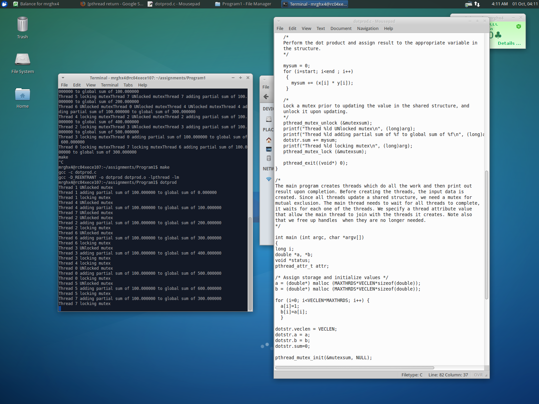
What if …

Slide 12
Will any/all threads exit?

Slide 13
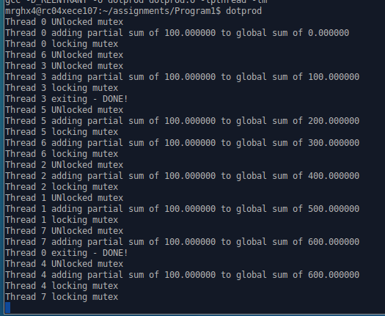

Slide 14
Lab #3
My “individual project”
NEU – 2016

Slide 15
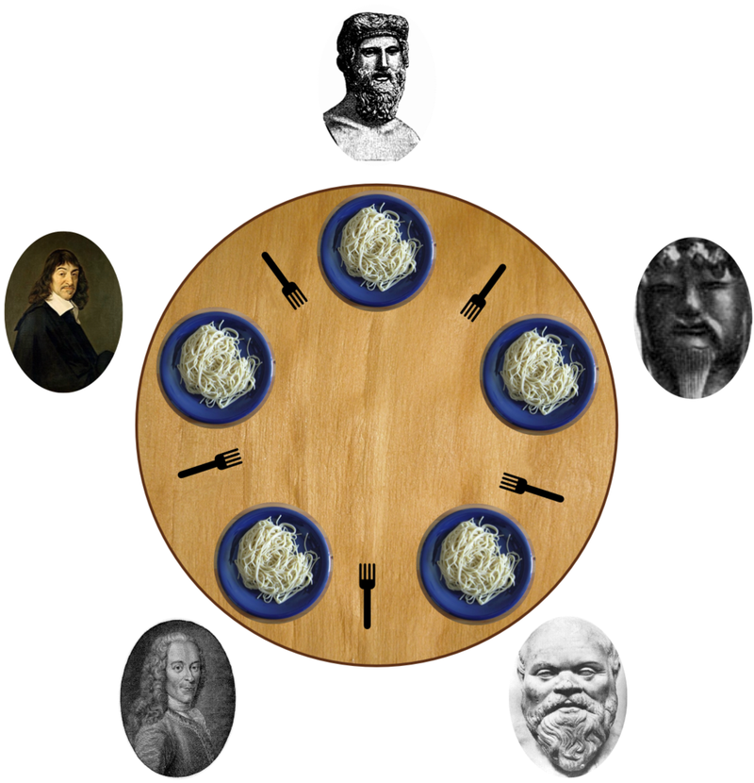
Impact of Queuing and Starvation
Dining Philosophers
MPI Implementation
Standard code from MPI assignment
FIFO Queue
Prioritized FIFO Queue
Notes:
Example Presentation to accompany the Example Project in Blackboard

Slide 16
Fork Master
FIFO Queue
Priority FIFO Queue
Simple queue
Unavailable requests get queued
Queue is checked upon fork return
Only first element checked
Prone to starvation
Queue is still FIFO
Entire queue is checked upon fork return (processed FIFO)
If a request is added to the queue, those forks are flagged
Any future request for a flagged fork gets queued
Processing un-flags forks

Slide 17
Analyses paths
Fix philosophers, vary delay
Fix delay, vary philosophers
5 philosophers
Average 100 “eats” per philosopher per simulation
Eating and Thinking times vary between 0 and MAXDELAY (-1) seconds
Eating and Thinking times are either 0 or 1 second
Average should be 0.5 sec
Average 100 “eats” per philosopher per simulation
How does the simulation scale?

Slide 18
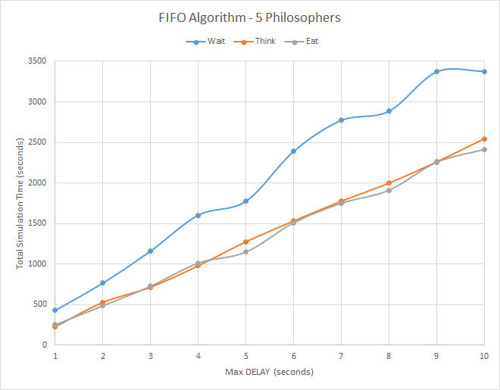
Impacts of random delay
Notes:
Each philosopher ate an average of 100 times

Slide 19
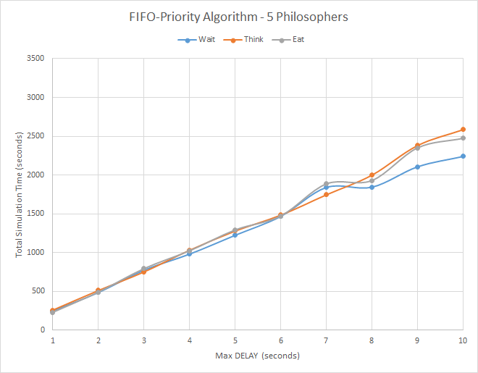
Impacts of random delay
Notes:
Each philosopher ate an average of 100 times

Slide 20
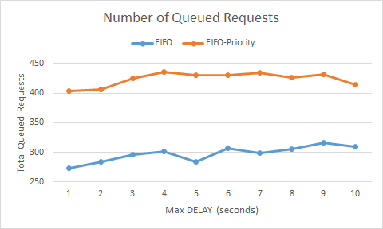
Analysis of Queues

Slide 21
How Scalable is our Solution?
Fix delay to 0 or 1 seconds
Normalize times to average per “eat”

Slide 22
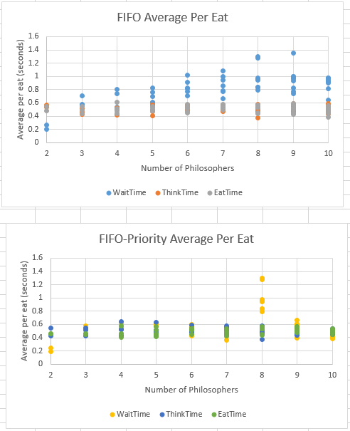
Average times per “eat”

Slide 23
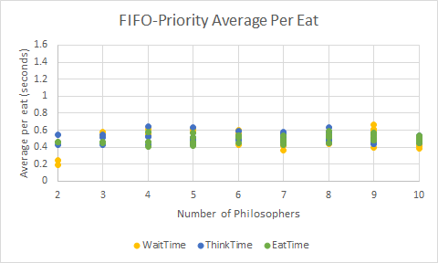
Average times per “eat” redo 8 phils…
Notes:
8 philosophers redone

Slide 24
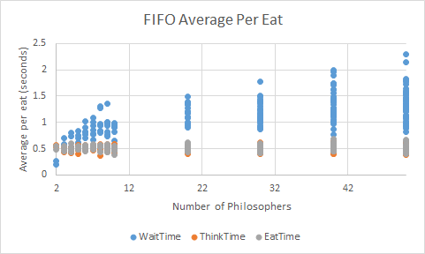
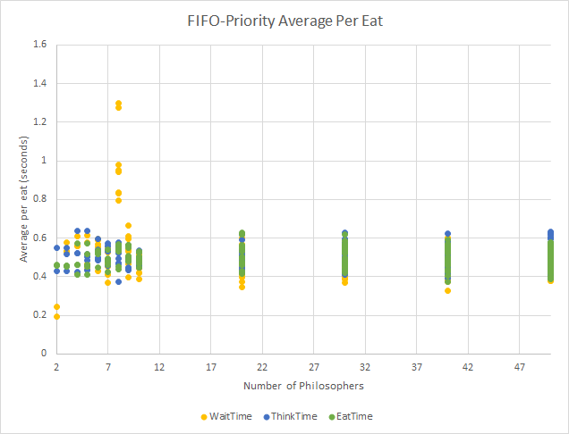

Slide 25
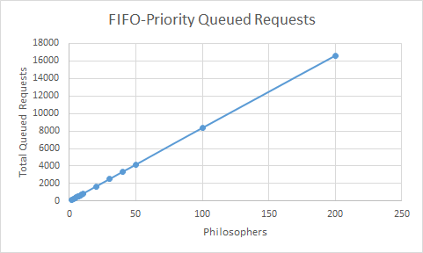
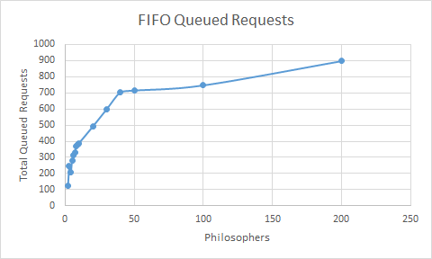
Queue requests scaling?

Slide 26
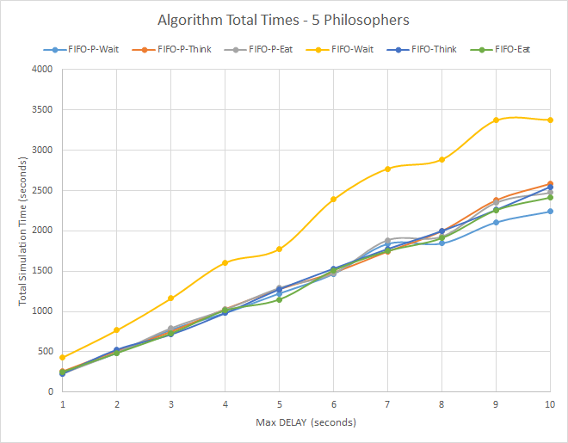
Conclusions
Notes:
Definitely scalable beyond what resources our experimental platform provided

Slide 27
MPI
Additional communication mechanisms for parallel processing

Slide 28
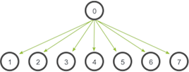
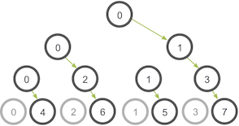
MPI Collective Communication
Broadcast

Slide 29
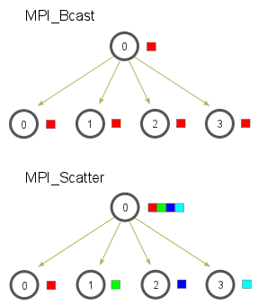
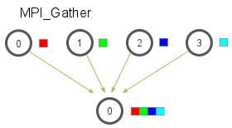
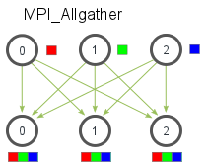

Slide 30
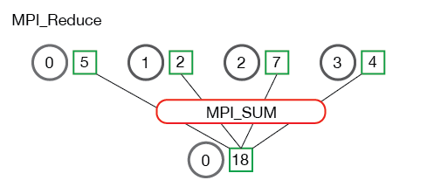
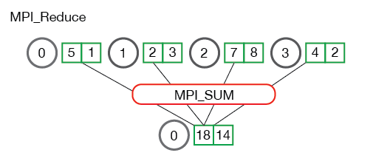
Collection & Processing
MPI_MAX - Returns the maximum element.
MPI_MIN - Returns the minimum element.
MPI_SUM - Sums the elements.
MPI_PROD - Multiplies all elements.
MPI_LAND - Performs a logical and across the elements.
MPI_LOR - Performs a logical or across the elements.
MPI_BAND - Performs a bitwise and across the bits of the elements.
MPI_BOR - Performs a bitwise or across the bits of the elements.

Slide 31
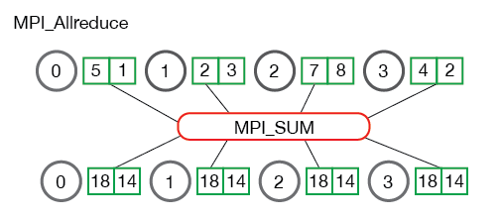
Like MPI_Reduce followed by MPI_Bcast

Slide 32
Scheduling Review

Slide 33
Notes:
Figure 9.2
reorganizes the state transition diagram of Figure 3.9b to suggest the nesting of
scheduling functions.

Slide 34
Table 9.5
A Comparison
of Scheduling Policies
(Table is on page 408 in textbook)
Notes:
Figure 9.5 and Table 9.5 show the results for our example using time quanta q
of 1 and 4 time units. Note that process E, which is the shortest job, enjoys significant
improvement for a time quantum of 1.

Slide 35
Table 9.3
Characteristics of Various Scheduling Policies
(Table can be found on page 405 in textbook)
Notes:
Table 9.3 presents some summary information about the various scheduling policies
that are examined in this subsection

Slide 36
Fair-Share Scheduling
Scheduling decisions based on the process sets
Time slicing across process sets
Each user is assigned a share of the processor
Objective is to monitor usage to give fewer resources to users who have had more than their fair share and more to those who have had less than their fair share
Notes:
All of the scheduling algorithms discussed so far treat the collection of ready
processes as a single pool of processes from which to select the next running process.
This pool may be broken down by priority but is otherwise homogeneous.
However, in a multiuser system, if individual user applications or jobs may be
organized as multiple processes (or threads), then there is a structure to the collection
of processes that is not recognized by a traditional scheduler. From the user’s
point of view, the concern is not how a particular process performs but rather how
his or her set of processes, which constitute a single application, performs. Thus, it
would be attractive to make scheduling decisions on the basis of these process sets.
This approach is generally known as fair-share scheduling. Further, the concept can
be extended to groups of users, even if each user is represented by a single process.
For example, in a time-sharing system, we might wish to consider all of the users
from a given department to be members of the same group. Scheduling decisions
could then be made that attempt to give each group similar service. Thus, if a large
number of people from one department log onto the system, we would like to see
response time degradation primarily affect members of that department rather than
users from other departments.
The term fair share indicates the philosophy behind such a scheduler. Each
user is assigned a weighting of some sort that defines that user’s share of system
resources as a fraction of the total usage of those resources. In particular, each
user is assigned a share of the processor. Such a scheme should operate in a more
or less linear fashion, so that if user A has twice the weighting of user B, then in
the long run, user A should be able to do twice as much work as user B. The objective
of a fair-share scheduler is to monitor usage to give fewer resources to users
who have had more than their fair share and more to those who have had less than
their fair share.

Slide 37
Notes:
Figure 9.16 is an example in which process A is in one group and processes B
and C are in a second group, with each group having a weighting of 0.5. Assume that
all processes are processor bound and are usually ready to run. All processes have
a base priority of 60. Processor utilization is measured as follows: The processor is
interrupted 60 times per second; during each interrupt, the processor usage field of
the currently running process is incremented, as is the corresponding group processor
field. Once per second, priorities are recalculated.
In the figure, process A is scheduled first. At the end of one second, it is
preempted. Processes B and C now have the higher priority, and process B is scheduled.
At the end of the second time unit, process A has the highest priority. Note
that the pattern repeats: the kernel schedules the processes in order: A, B, A, C, A,
B, and so on. Thus, 50% of the processor is allocated to process A, which constitutes
one group, and 50% to processes B and C, which constitute another group.

